Slide 1

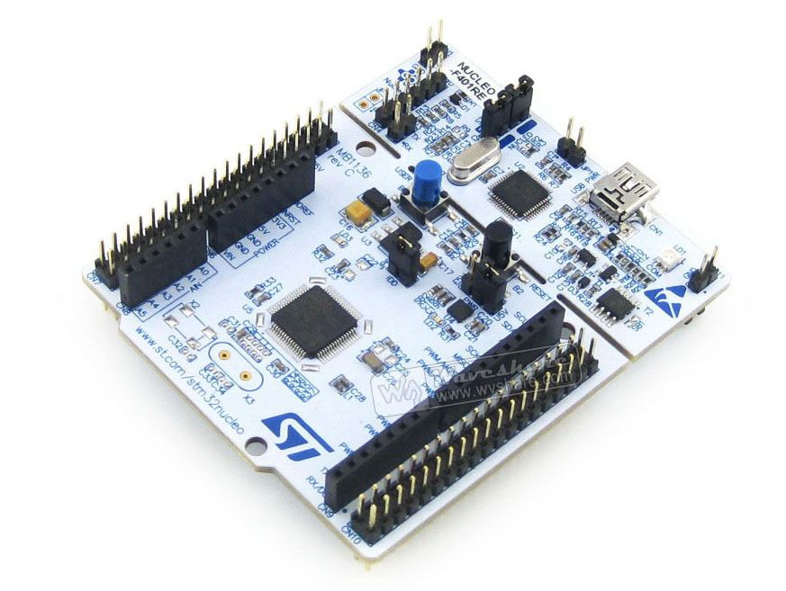
STM32F411 Nucleo Board
Athanasiadis angelos
Karanassos dimitrios

Slide 2
STM32F411 Nucleo Board

Slide 3
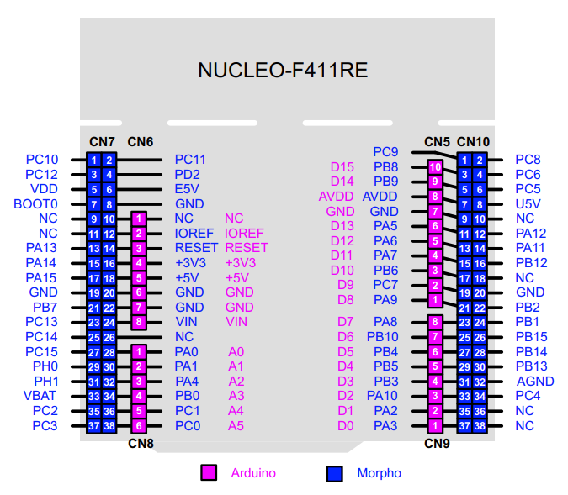
Board IO Pins Ardunio Compatible

Slide 4
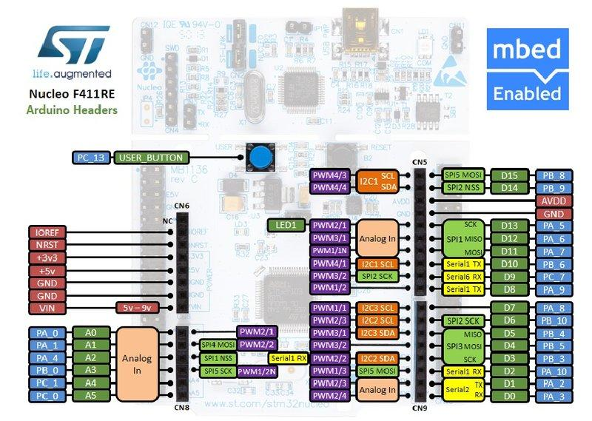
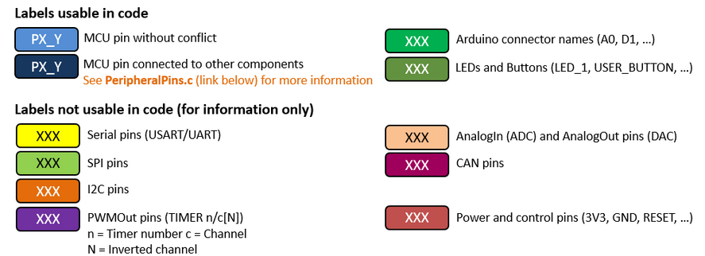
Nucleo Board Pinouts

Slide 5
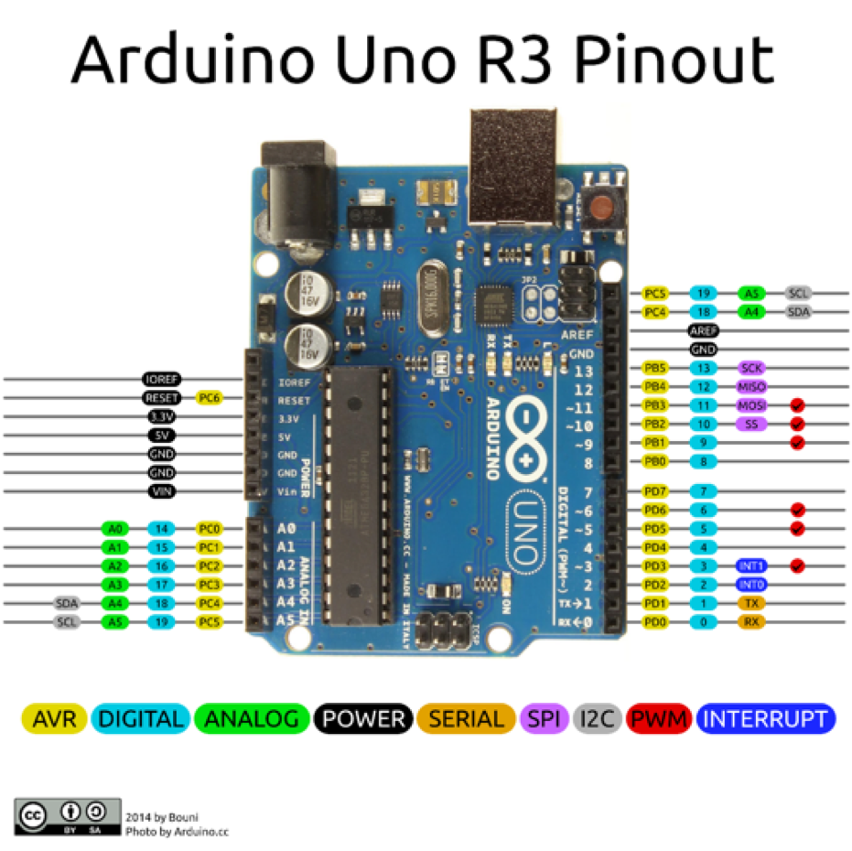
Comparing Arduino and Nucleo Board

Slide 6
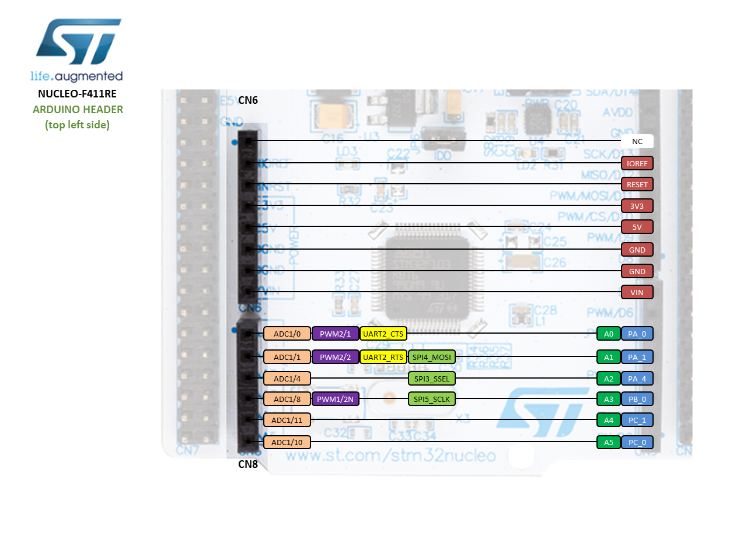
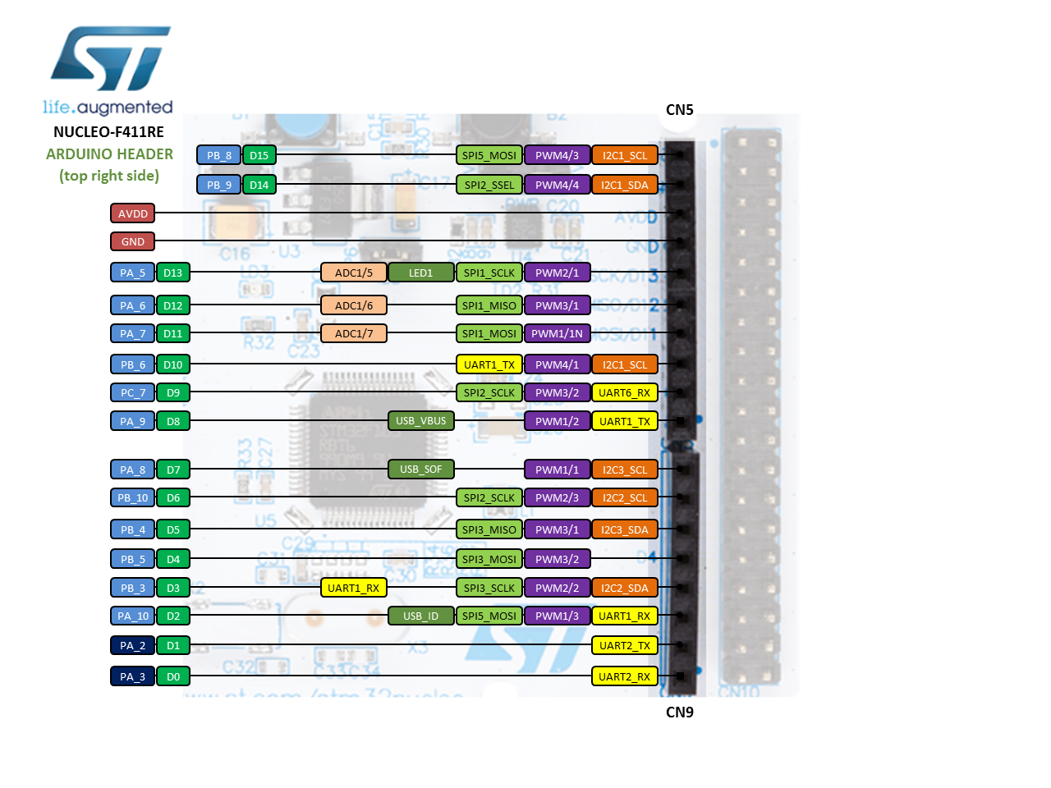
Arduino-compatible headers

Slide 7
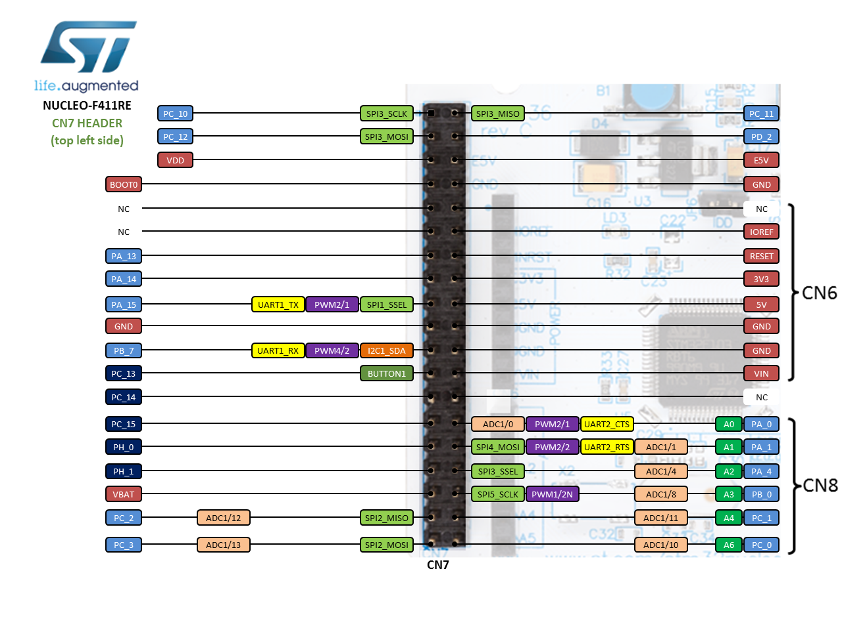
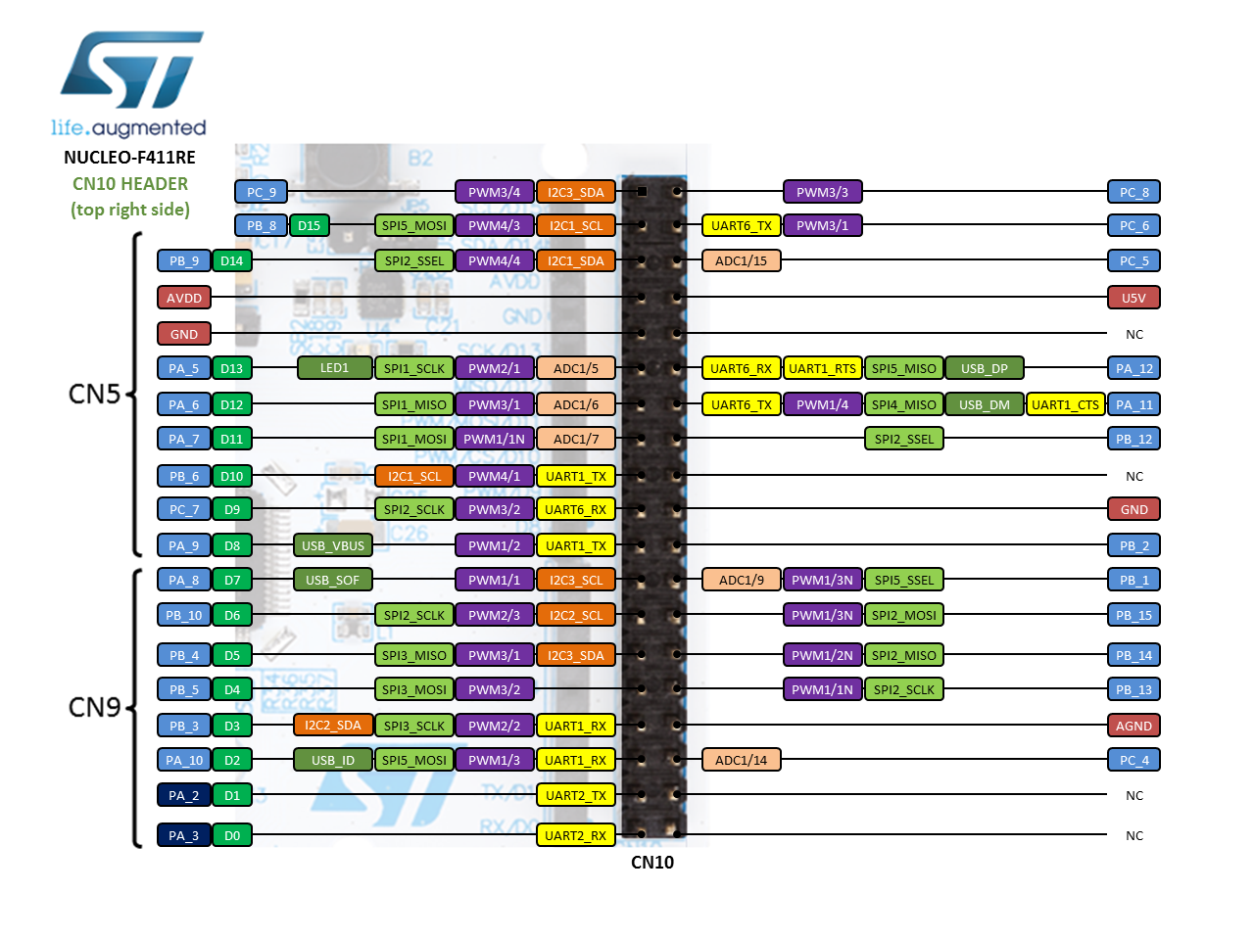
Morpho headers

Slide 8
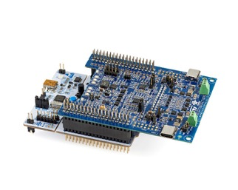
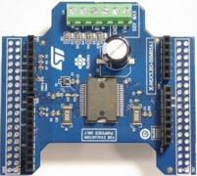
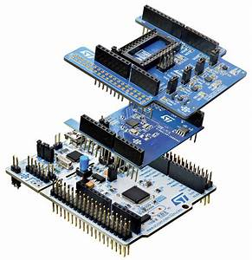
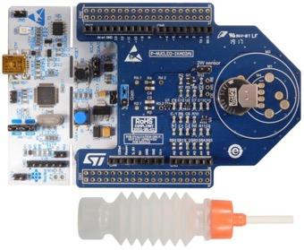
Expansion Shields for Nucleo Board

Slide 9
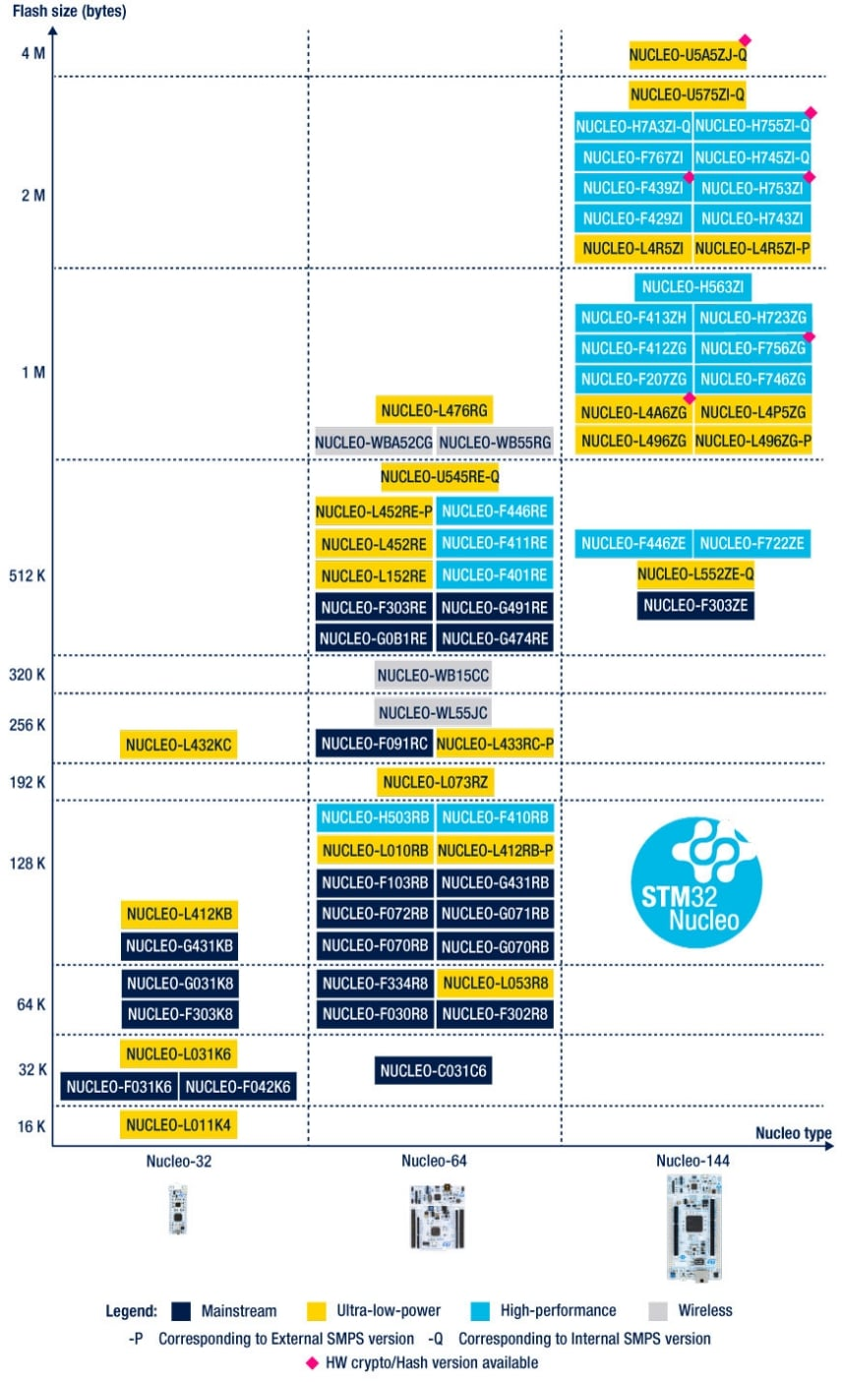
STM32 Nucleo Ecosystem

Slide 10
STM32F411RE MCU – STM32F411RET6
STM32F411RET6 in LQFP64 package
ARM®32-bit Cortex®-M4 CPU with FPU
100 MHz max CPU frequency
VDD from 1.7 V to 3.6 V
512 KB Flash and 128 KB SRAM
GPIO (50) with external interrupt capability
12-bit ADC with 16 channels
RTC and Timers (8)
I2C (3) - USART (3) - SPI (5)
USB OTG Full Speed
SDIO

Slide 11
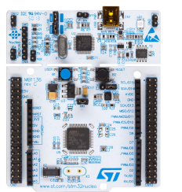
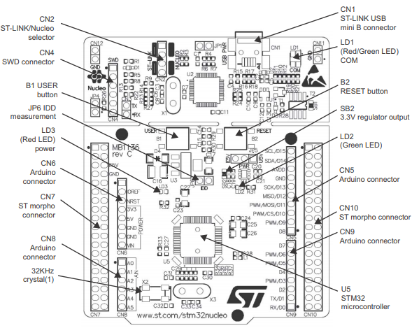
STM32F411RE MCU Zooming in

Slide 12
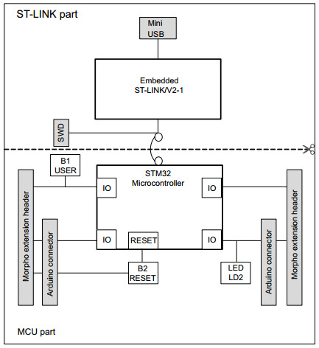
System View
The ST-LINK allows us to program the board

Slide 13
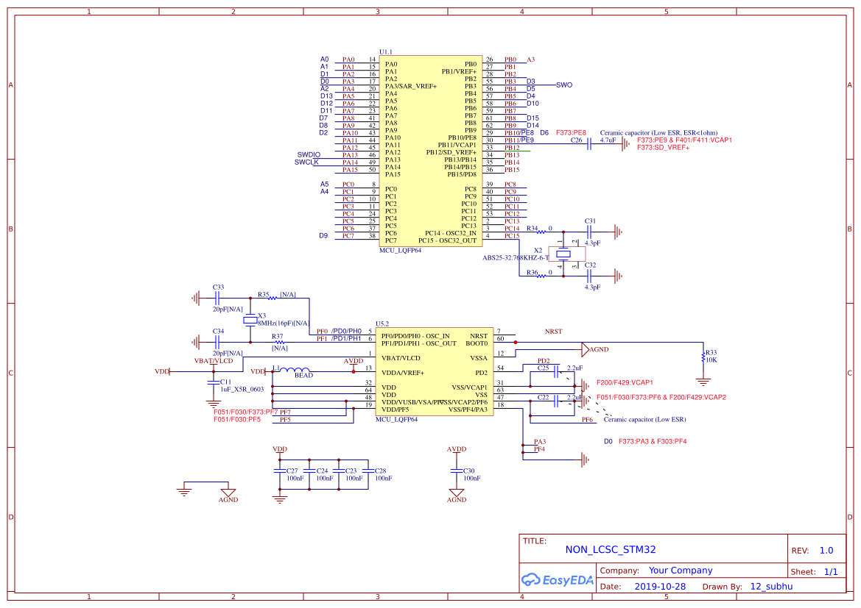
Board Schematic

Slide 14
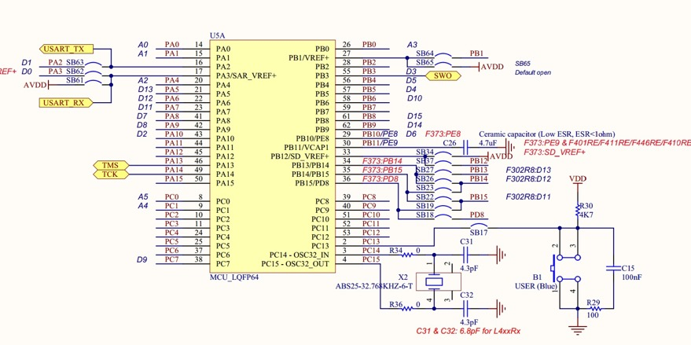
Board Schematic Use the bush button

Slide 15
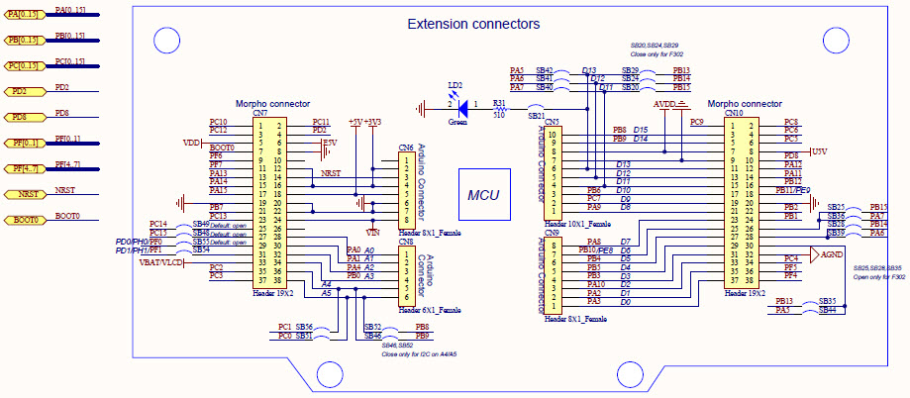
Extension Connectors

Slide 16
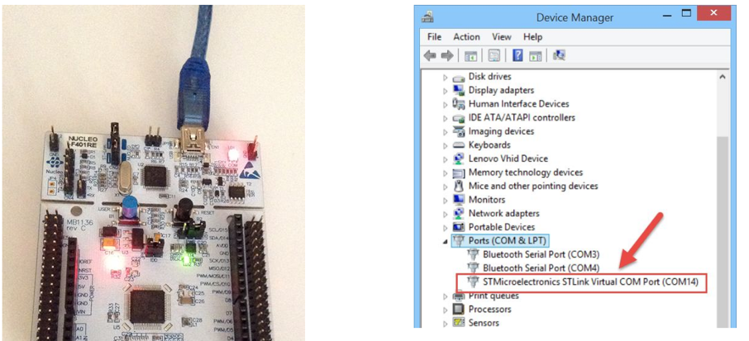
Checking your Connection

Slide 17
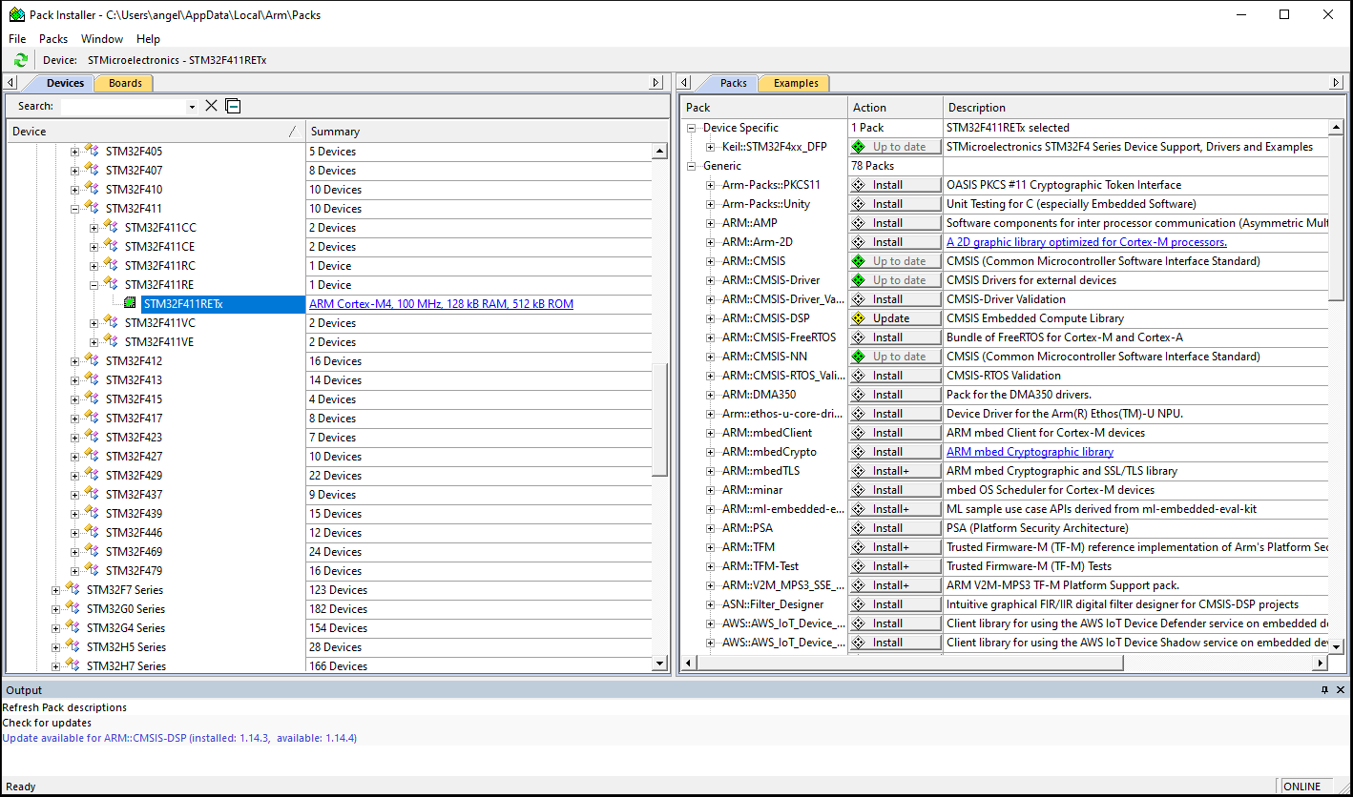
Start a NEW project in your Keil
On the left side of the window under Devices, click to expand STMicroelectronics. • Find STM32F4 Series and expand it • Double click on STM32F411RE and it should add it to the packs list on the right side. • Click all the buttons that say Install or Update to get all the features/packages that Keil offers.

Slide 18
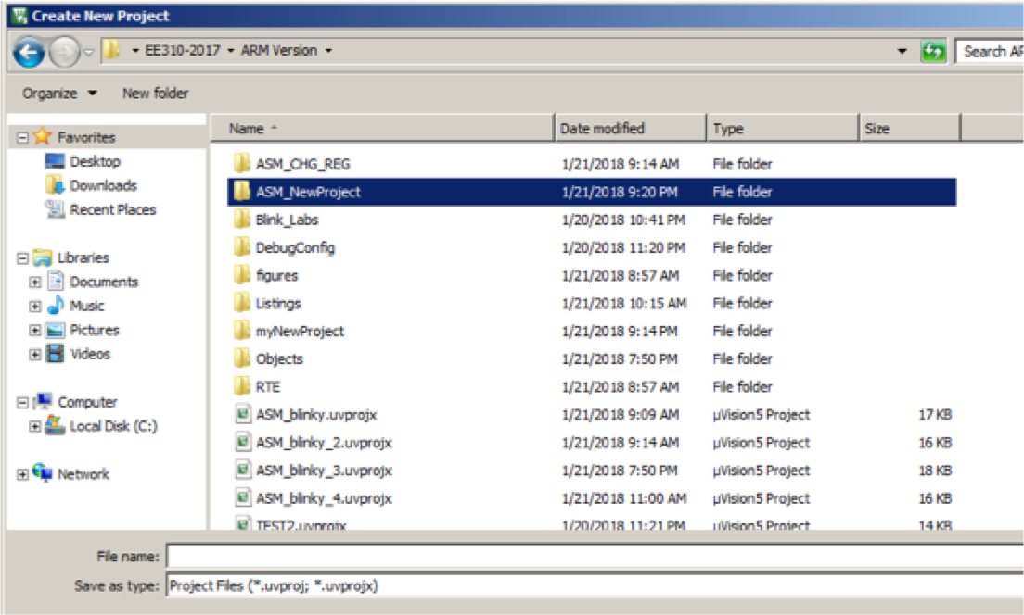
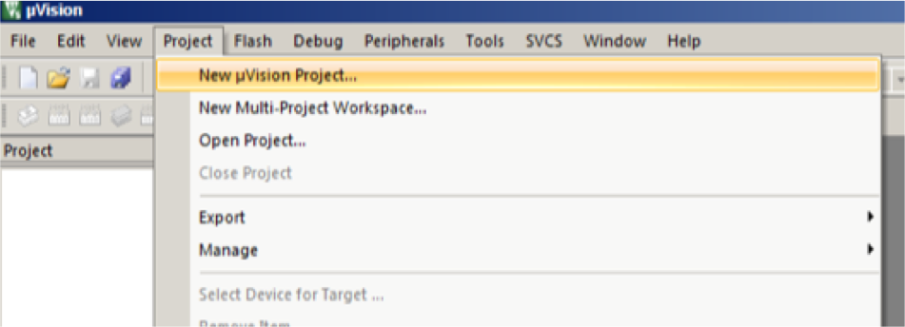
Start A New Project
• Open Keil uVision 5 from your Windows • Make sure all projects are closed: • Project -> Close Project • Click on Project -> new uVision Project … • In the window click on New Folder • Type the name of the project: ASM_NewProject • Go to the new folder that you just created

Slide 19
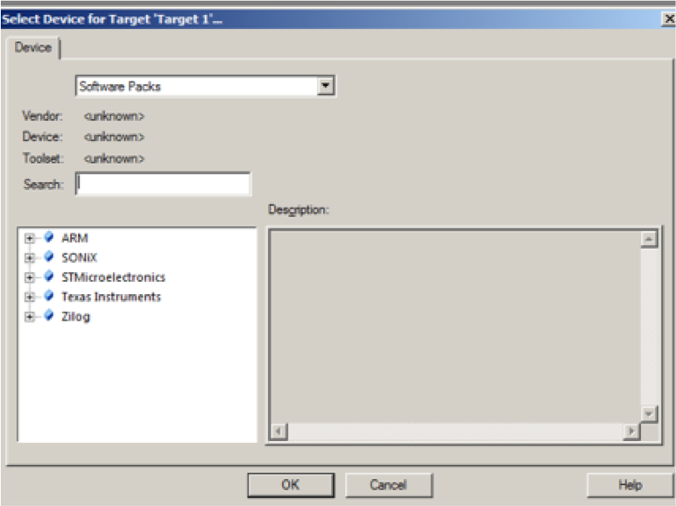
Start A New Project
• The Select Device window pops up • In the search type: STM32F411RETx • Click on the device (STM32F411RETx) that showed up and then click OK

Slide 20
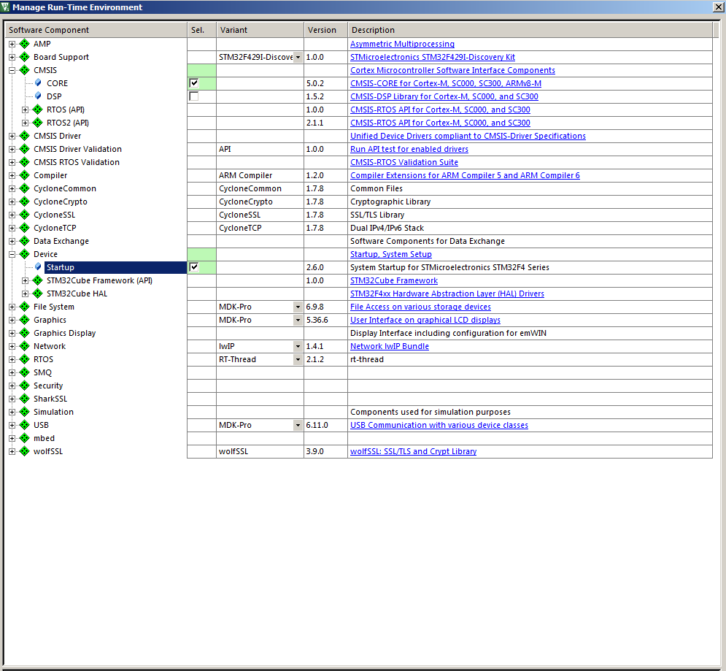
Start A New Project
• At this point the Manage Run window pops up • CHECK CMSIS -> CORE and DEVICE->STARTUP boxes – note that the color changes • Then click OK

Slide 21
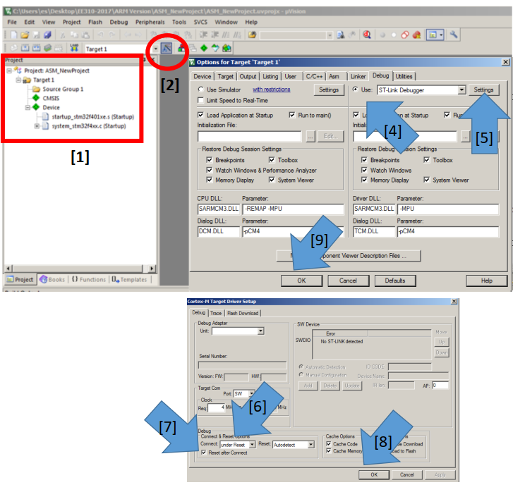
Start A New Project
At tis point your Project window should show the CMSIS and DEVICE – these are the CMSIS system initialization files and startup files in order for the RUN TIME to operate [1] • Click on the OPTIONS FOR TARGET [2] • Click on DEBUG tab [3] • CHECK and Select the USE ST-LINK [4] • Click on Setting [5] • In the CORTEX-M4 Target Drive • Choose Under Reset [6] • Check RESET AFTER CONTROL Box [7] • Click ok [8] • In the OPTIONS window, Click on OK [9] • In the PROJECT window click on Source Group 1 and select ADD NEW ITEM…. • In the new window select

Slide 22
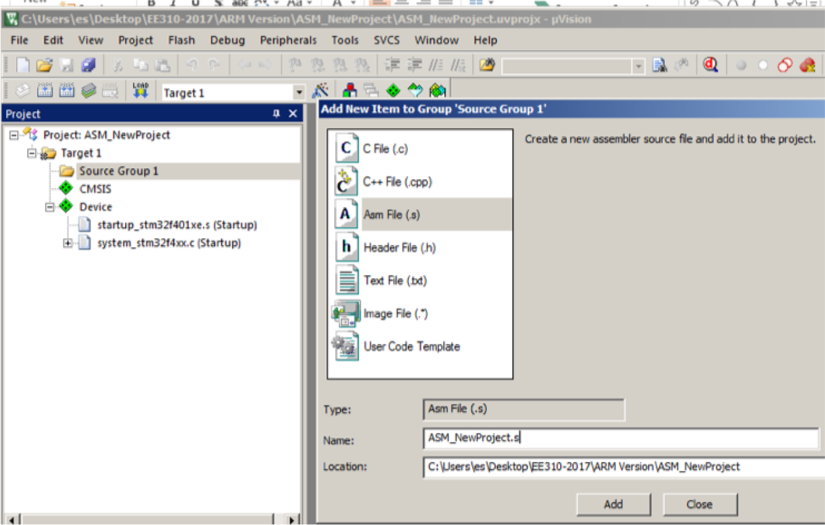
Start A New Project
• In the PROJECT window click on Source Group 1 and select ADD NEW ITEM…. • In the new window select ASM files • Then type the name of the ASM file: ASM_NewProject.s • Click on ADD

Slide 23
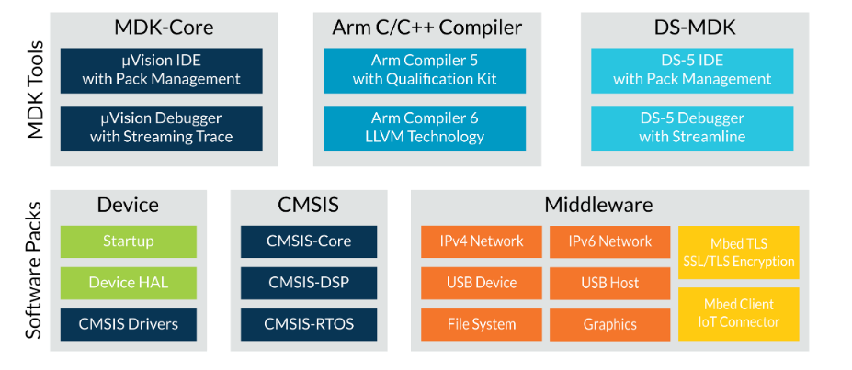
Arm Keil MDK
Arm® Keil® MDK is the most comprehensive software development solution for Arm Cortex®-based microcontrollers. Every MDK edition includes IDE, C/C++ compiler, debugger, software pack management, and CMSIS

Slide 24
Arm Keil MDK
MDK-Core offers leading support for over 3,750 Cortex-M based devices including the new Arm Cortex-M23/M33 cores. The μVision debugger includes event recorder and component viewer to show run-time behavior of software components. Together with the ULINKpro™ debug adapter, it offers full instruction trace and complete code coverage information.
DS-MDK contains the Eclipse-based DS-5 IDE/debugger and supports 32-bit Cortex-A processors or hybrid systems with 32-bit Cortex-A and Cortex-M. Streamline performance analyzer helps to get the best out of the system’s resources and create high performance, energy efficient products.
Software packs can be added any time to MDK-Core or DS-MDK making new device support and middleware updates independent from the toolchain. They contain device support, CMSIS libraries, software components, middleware, board support, code templates, and example projects.
MDK middleware provides royalty-free, tightly-coupled software components that are specifically designed for communication peripherals in microcontrollers.

Slide 25
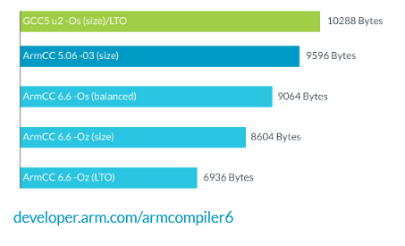
Arm Keil MDK
The industry-leading Arm C/C++ Compilers with assembler, linker, and highly optimized run-time libraries are tailored for optimum code size and performance.
Arm Compiler 5 is certified for functional safety applications and offers long-term maintenance and support.Arm Compiler 6 offer the best code size currently on the market.
It offers various optimization levels including Link Time Optimization. This diagram shows the code size.

Slide 26
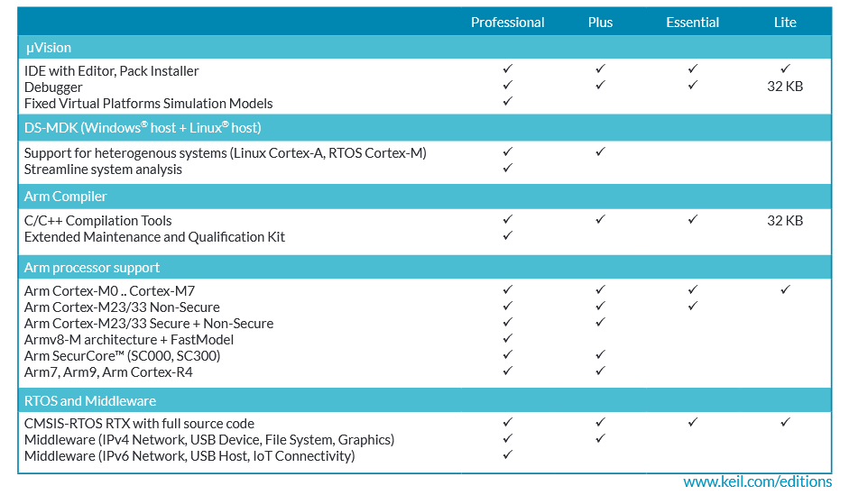
MDK editions and ULINK debug adapters

Slide 27
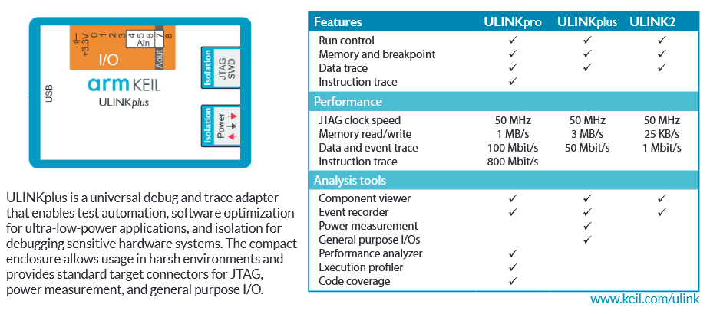
MDK editions and ULINK debug adapters

Slide 28
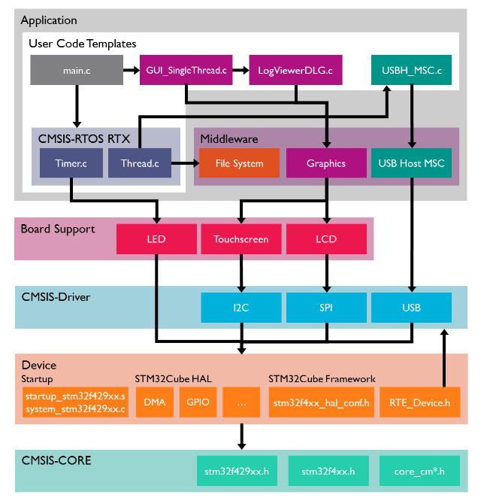

CMSIS Components
The Cortex Microcontroller Software Interface Standard (CMSIS) is a vendor-independent hardware abstraction layer for microcontrollers that are based on Arm® Cortex® processors. It defines generic tool interfaces and enables consistent device support. Its software interfaces simplify software re-use, reduce the learning curve for microcontroller developers, and improve time to market for new devices.
CMSIS provides interfaces to processor and peripherals, real-time operating systems, and middleware components. It includes a delivery mechanism for devices, boards, and software and enables the combination of software components from multiple vendors.

Slide 29
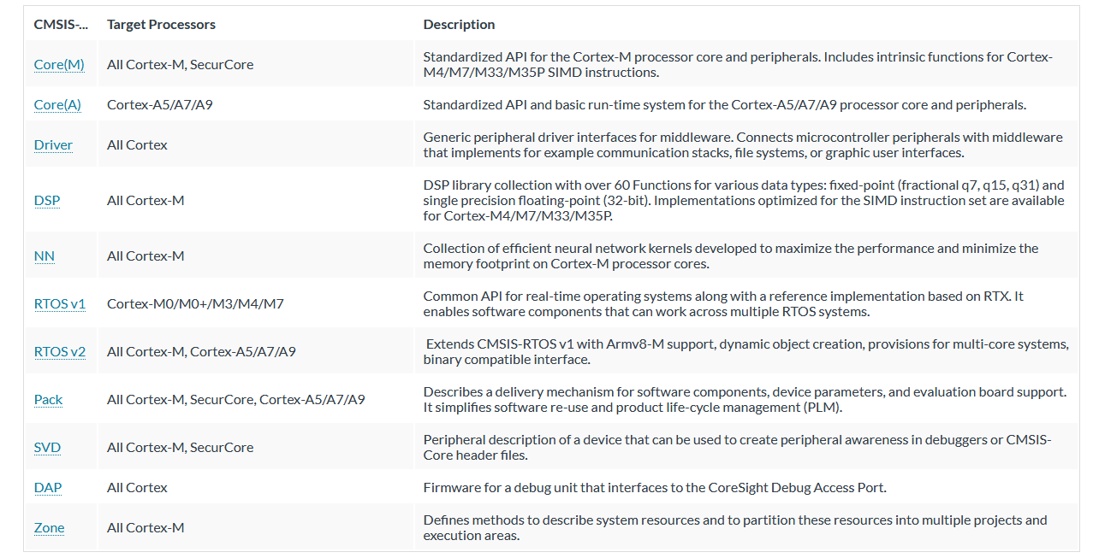
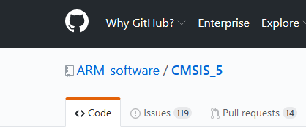
CMSIS Components

Slide 30
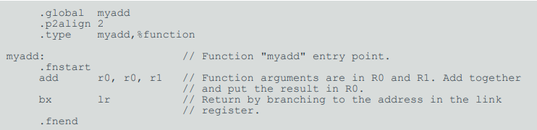
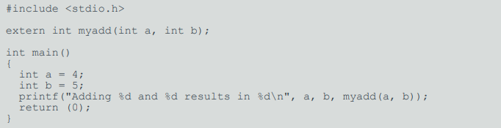
Tips: 1st Assignment
Create an assembly (.s) file in your source folder
In the assembly source, declare the code as a global function using .global and .type:
In C code, declare the external function using extern:

Slide 31
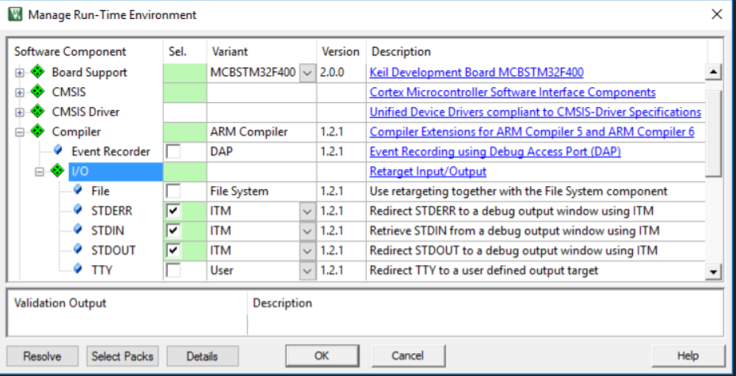
Tips: How to enable Keil-printf (1)
Open the Manage RTE dialog and expand the Compiler -- I/O folder
Check the STDERR, STDIN and STDOUT components and set the Variant to ITM for each component.

Slide 32
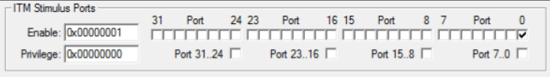
Tips: How to enable Keil-printf (2)
Add a debugging trace messages using printf
Set up the debug session for SWO trace
Trace Enable
Set Core Clock (usually 16MHz)
Set the ITM Port 0 to capture the information. Clear the Privilege Port 7..0 to access ITM Port 0 from User Mode.
Open the window from the menu View - Serial Windows - Debug (printf) Viewer.

Slide 33
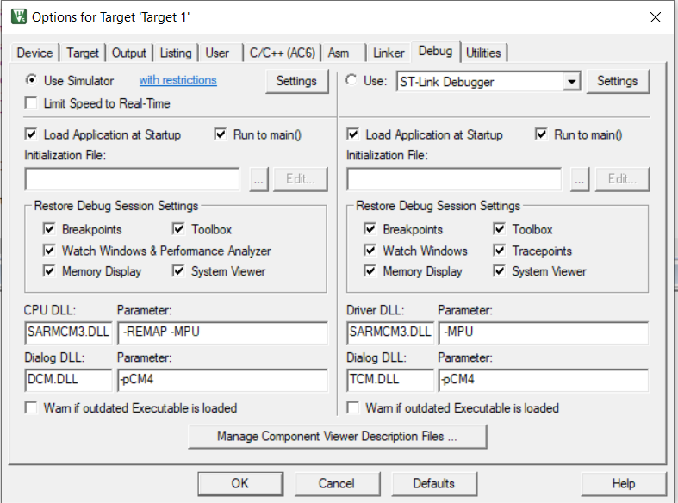
Tips: How to enable Simulation
Click on Options for Target…
Click Debug
Enable the Use Simulator option

